Slide 1
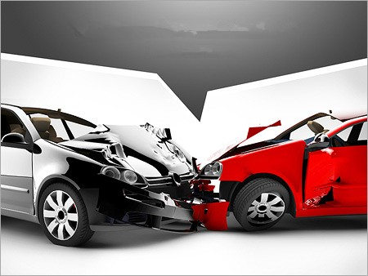
Road Accident Analysis India 2020 –
AI-Powered Policy Simulation and
Predictive Modeling
Platform: Google Colab
Presented by: Sahana Sunddher

Slide 2

Table Of Contents
Introduction
Project Workflow Overview
Dataset Overview
Data Preparation, Exploration & ML Modeling
Examples
My Novelty
Future Scope
Conclusion

Slide 3
Introduction
Road accidents are a significant concern in India's urban cities. The 2020 dataset contains detailed accident causes, outcomes, and locations for 50 Indian cities.
I have Used Data Science to analyze, predict, and simulate policies that could reduce accidents and fatalities.
Tools Used:
Python
Pandas
Matplotlib
Scikit-learn

Slide 4

Project Workflow Overview
Load and clean data
Exploratory Data Analysis (EDA)
Predict fatal accidents (ML model)
Simulate policy impact (Novelty)
Cluster cities for policy targeting
Draw insights and recommendations

Slide 5
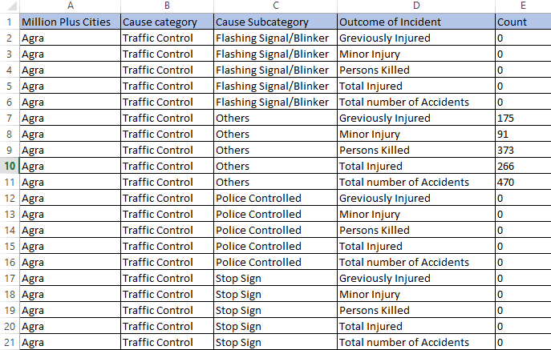
Dataset Overview
Source: data.gov.in (2020 Road Accidents in India)
Total Records: 9550 rows, 50 cities

Slide 6
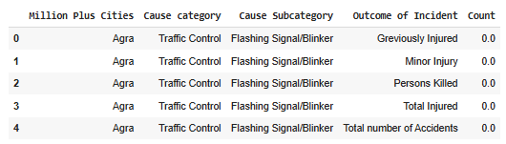
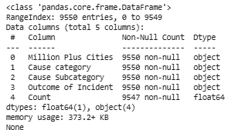
Data Preparation, Exploration & ML Modeling
Data Loading & Cleaning
Loaded accident data for 50 Indian cities (2020)
Cleaned missing values in 'Count' column
Standardized text (title case, stripped spaces)
Verified data types, ready for ML modeling
Total Records after cleaning: 9,550

Slide 7
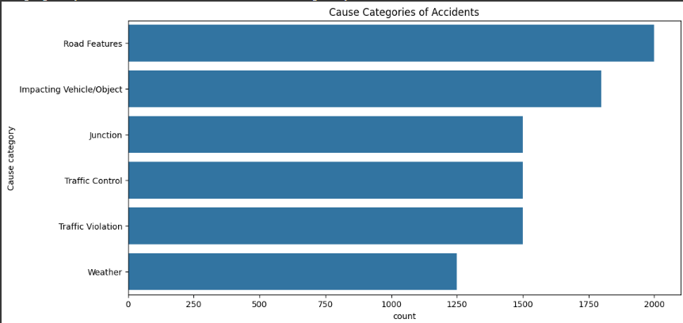
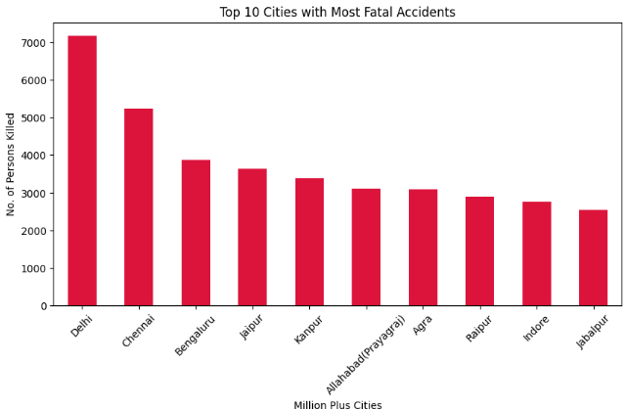
Exploratory Data Analysis (EDA)
Identified top cities with high fatality rates
Highlighted major causes:
Road Features
Traffic Control
Drunken Driving
Outcomes explored:
Persons Killed
Minor Injuries
Total Accidents
Visual Insights:
Bar Chart: Cities with most fatalities
Bar Chart: Common accident causes
Pie Chart: Outcome distribution

Slide 8
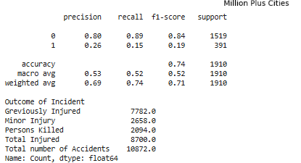
Machine Learning Model – Predicting Fatal Accidents
Model: Random Forest Classifier
Target: Is Fatal → 1 if 'Persons Killed', else 0
Features: Cause Category, Subcategory, Count
Output: Predicts probability of fatality for an incident
Supports early warning and risk prioritization

Slide 9
What is Policy Simulation?
It is a smart function I created that shows what would happen if we reduced a specific cause of road accidents like fixing potholes or preventing drunken driving in a specific city.
Why is this Important?
Helps predict the impact of government actions before they are implemented.
Useful for policymakers, traffic authorities, and city planners.
Turns data into actionable decisions.
How Does It Work?
I select a city and a cause (e.g., ‘Drunken Driving’ in Delhi).
I simulate a reduction in that cause (e.g., 60% reduction).
The program calculates and shows the new number of accidents, injuries, and deaths.
It shows a before vs after comparison using a bar chart.

Slide 10
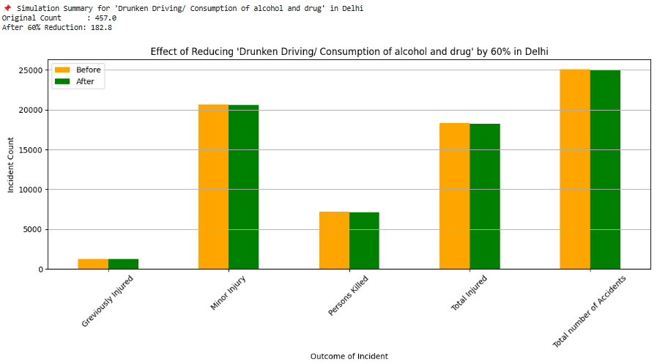
Example 1
“If Drunken Driving is reduced by 60% in Delhi:”
Number of fatalities drops clearly.
Total injuries also reduce.
Visual chart shows the difference, makes the impact easy to understand.

Slide 11
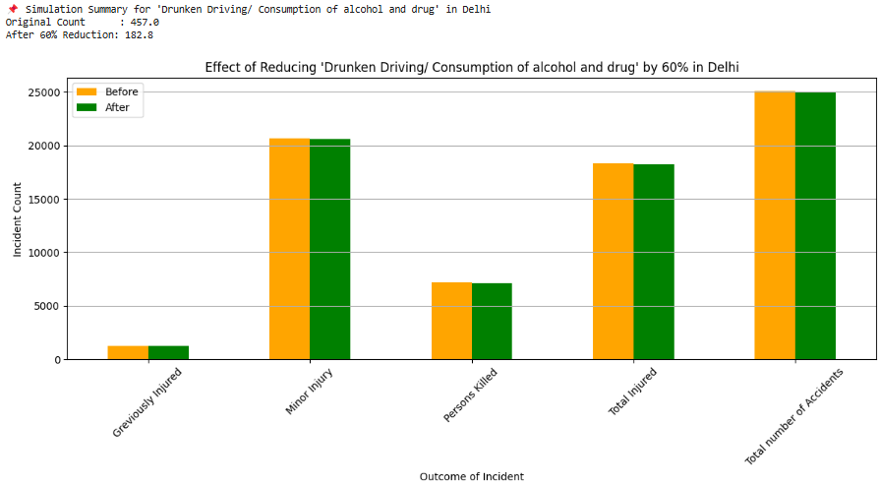
Example 2
“Over-speeding ↓ 50% in Mumbai”
Significant drop in fatalities
Minor & grievous injuries also decrease
Visual clearly shows improved safety by controlling speed

Slide 12
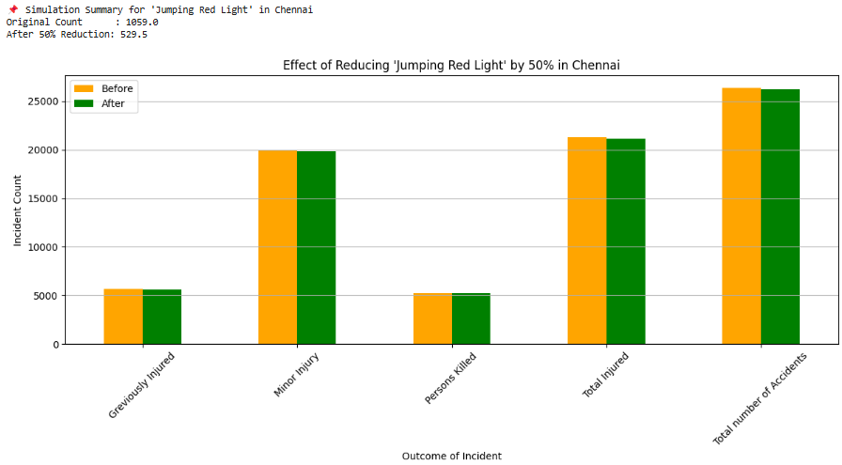
Example 3
“Jumping Red Light ↓ 50% in Chennai”
Clear reduction in accidents & injuries
Minor injuries and total accidents drop
Visual proves how traffic signal enforcement improves road safety

Slide 13


My Novelty
Future Scope
Policy Simulation Function:
Simulates the impact of reducing specific accident causes with before-and-after visual comparisons.
Fatality Prediction using Machine Learning:
Random Forest model predicts the likelihood of fatal outcomes.
City Clustering:
Groups cities based on accident patterns to enable targeted policy planning.
Integrate real-time accident and traffic data.
Develop an interactive simulation dashboard using Streamlit.
Implement geo-spatial visualization for city-level insights.
Apply NLP to correlate accident data with news trends.

Slide 14
Conclusion
My project provides a comprehensive analysis of road accidents across major Indian cities using real-world data. By combining Exploratory Data Analysis, Machine Learning, and a novel Policy Simulation function, it delivers actionable insights to improve road safety.
The simulation model helps visualize the potential impact of targeted interventions, while predictive modeling and city clustering support data-driven decision-making.
Overall, my project demonstrates how data science can be effectively applied to
public safety and urban planning.

Slide 15

Thank You

